Slide 1
Bayesian Learning
Slides adapted from Nathalie Japkowicz and David Kauchak
TexPoint fonts used in EMF.
Read the TexPoint manual before you delete this box.: 

Slide 2
Bayesian Learning
Increasingly popular framework for learning
Strong (Bayesian) statistical underpinnings
Timeline: Bayesian Decision Theory came before Version Spaces, Decision Tree Learning and Neural Networks

Slide 3
Statistical Reasoning
Two schools of thought on probabilities
Frequentist
Probabilities represent long run frequencies
Sampling is infinite
Decision rules can be sharp
Bayesian
Probabilities indicate the plausibility of an event
State of the world can always be updated
In many cases, the conclusion is the same.

Slide 4
Unconditional/Prior probability
Simplest form of probability is:
P(X)
Prior probability: without any additional information…
What is the probability of a heads?
What is the probability of surviving the titanic?
What is the probability of a wine review containing the word “banana”?
What is the probability of a passenger on the titanic being under 21 years old?

Slide 5
Joint Distribution
Probability distributions over multiple variables
P(X,Y)
probability of X and Y
a distribution over the cross product of possible values

Slide 6
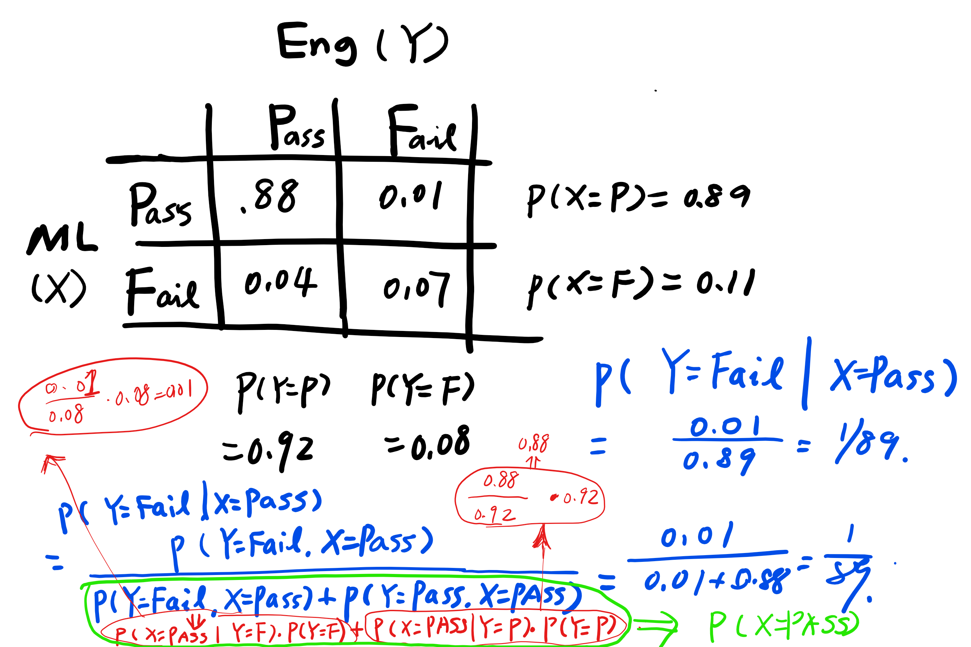
Joint probability
P(X,Y)
Marginal distributions
Conditional probability

Slide 7
Conditional Probability
As we learn more information, we can update our probability distribution
P(X|Y) ≡ “probability of X given Y”
What is the probability of a heads given that both sides of the coin are heads?
What is the probability the document is about Chardonnay, given that it contains the word “Pinot”?
What is the probability of the word “noir” given that the sentence also contains the word “pinot”?
Notice that it is still a distribution over the values of X

Slide 8
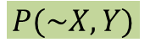
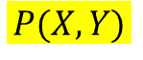
Conditional Probability
Given that y has happened, in what proportion of those events does x also happen
x
y
$$P(X,Y)$$
$$P(\sim X,Y)$$
$P\left(X | Y\right)=\frac{P(X,Y)}{P\left(\sim X,Y\right)+P(X,Y)}=$ $\frac{P(X,Y)}{\sum_{i}{P(X_{i},Y)}}=\frac{P(X,Y)}{\sum_{i}{P\left({Y|X}_{i}\right)p(X_{i})}}$

Slide 9
Both are Distributions over X
Conditional probability
Unconditional/prior
probability
MLPass | P(MLPass)
true | 0.89
false | 0.11
MLPass | P(MLPass|EngPass=false)
true | 0.125
false | 0.875

Slide 10
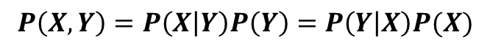
Chain rule (aka product rule)
$$P\left(X,Y\right)=P\left(X | Y\right)P\left(Y\right)=P\left(Y | X\right)P(X)$$
We can view calculating the probability of X AND Y occurring as two steps:
Y occurs with some probability P(Y)
Then, X occurs, given that Y has occurred
Works with more than 2 variables…

Slide 11
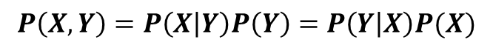
Bayes’ Rule
$$P\left(X,Y\right)=P\left(X | Y\right)P\left(Y\right)=P\left(Y | X\right)P(X)$$
Allows us to use P(Y|X) rather than P(X|Y)
Sometimes this can be more intuitive
Back to Machine Learning…

Slide 12
Probabilistic Modeling
Model the data with probabilistic model
Want to learn: p(features, label)
tells us how likely these features and this label are
train
probabilistic model
training data

Slide 13
Example: Fruit Classification
Training data
examples
label
red, round, leaf, 3oz, …
apple
train
probabilistic model:
p(features, label)
green, round, no leaf, 4oz, …
apple
yellow, curved, no leaf, 4oz, …
banana
green, curved, no leaf, 5oz, …
banana

Slide 14
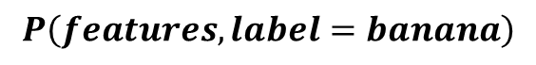
Probabilistic Models
Probabilistic models define a probability distribution over features and labels:
probabilistic model:
p(features, label)
yellow, curved, no leaf, 6oz, banana
0.004
$$P\left(features,label=banana\right)$$
$$P\left(label=banana|features\right)=\frac{P(label=banana,feature)}{P\left(label=banana,feature\right)+P(label\sim =banana,feature)}$$

Slide 15
Probabilistic Model vs. Classifier
Probabilistic model:
probabilistic model:
p(features, label)
yellow, curved, no leaf, 6oz, banana
0.004
Classifier:
yellow, curved, no leaf, 6oz
Classifier
banana
Given an unlabeled example, how do we use a probabilistic model for classification?

Slide 16
Probabilistic Models
Probabilistic models define a probability distribution over features and labels:
yellow, curved, no leaf, 6oz, banana
probabilistic model:
p(features, label)
0.004
0.00002
yellow, curved, no leaf, 6oz, apple
For each label, ask for the probability under the model
Pick the label with the highest probability
Why probabilistic models?

Slide 17
Probabilistic Models
Probabilities are nice to work with
range between 0 and 1
can combine them in a well understood way
lots of mathematical background/theory
Provide a strong, well-founded groundwork
Allow us to make clear decisions about things like regularization
Tend to be much less “heuristic” than the models we’ve seen
Different models have very clear meanings

Slide 18
Common Features in Bayesian Methods
Prior knowledge can be incorporated
Principled way to bias learner
Hypotheses are assigned probabilities
Provides probabilistic classifications
“It will rain tomorrow with 90% certainty”
Useful in comparing classifications

Slide 19
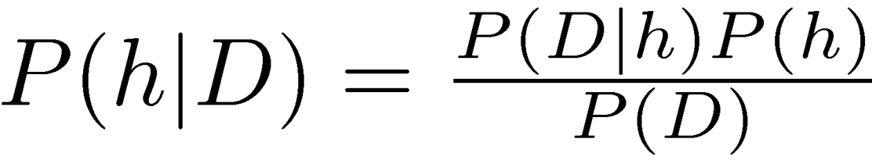
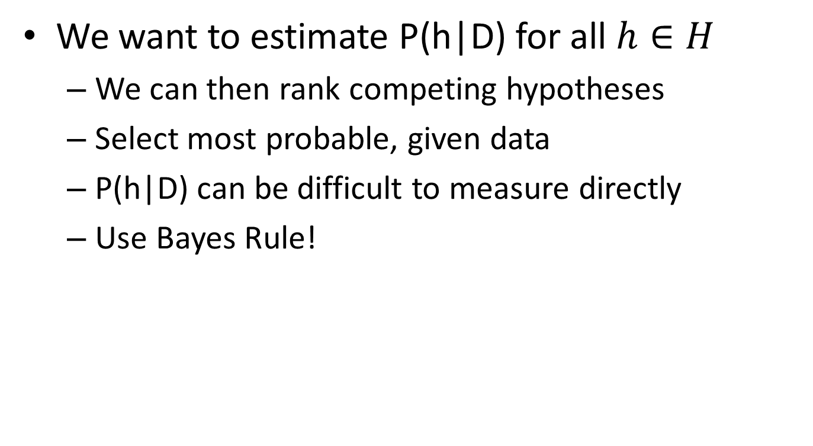
Back to Bayes Rule
Hypothesis
Data
We want to estimate P(h|D) for all $h∈H$
We can then rank competing hypotheses
Select most probable, given data
P(h|D) can be difficult to measure directly
Use Bayes Rule!

Slide 20
Terms
Likelihood
Posterior
Prior
Posterior: P(h|D)
What we want to solve for!
Reflects our confidence that h holds after we have seen training data D
Likelikhood: P(D|h)
If h holds, how likely is this data?
Prior: P(h):
Probability of hypothesis h, regardless of data
Reflects background knowledge
Data: P(D):
Reflects the prob. that training data D will be observed
This is the least important term

Slide 21
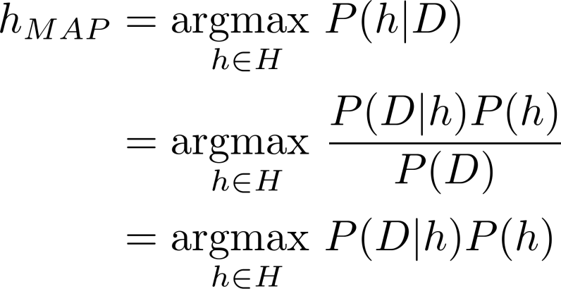
Maximum A Posteriori (MAP) Hypothesis
Usually, we want to find most likely h 2 H
This is the maximally probable hypothesis
Most likely, given data
All the same!
So, we can drop P(D)

Slide 22
Maximum Likelihood (ML) Hypothesis
What should we do if we don’t know anything about the likelihoods of h 2 H?
If every h 2 H is equally probable a priori, we don’t need to include prior P(h) since they are the same
only need to consider the likelihood P(D|h)
Then, h_{MAP} becomes the Maximum Likelihood,
h_{ML}= argmax _{h∈H} P(D|h)P(h)
h_{ML}= argmax _{h∈H} P(D|h)
All the same!

Slide 23
MAP vs. ML (Example)
Consider a rare disease X
There exists an imperfect test to detect X
2 Hypotheses:
Patient has disease (X)
Patient does not have disease (~X)
Test for disease exists
Returns “Pos” or “Neg”

Slide 24
Example (cont’d)
P(X) = 0.008
P(~X) = 1 – P(X) = .992
P(Pos | X) = .98 prob. test is accurate
P(Neg | X) = .02
P(Neg | ~X) = .97 prob. test is accurate
P(Pos | ~X) = .03

Slide 25
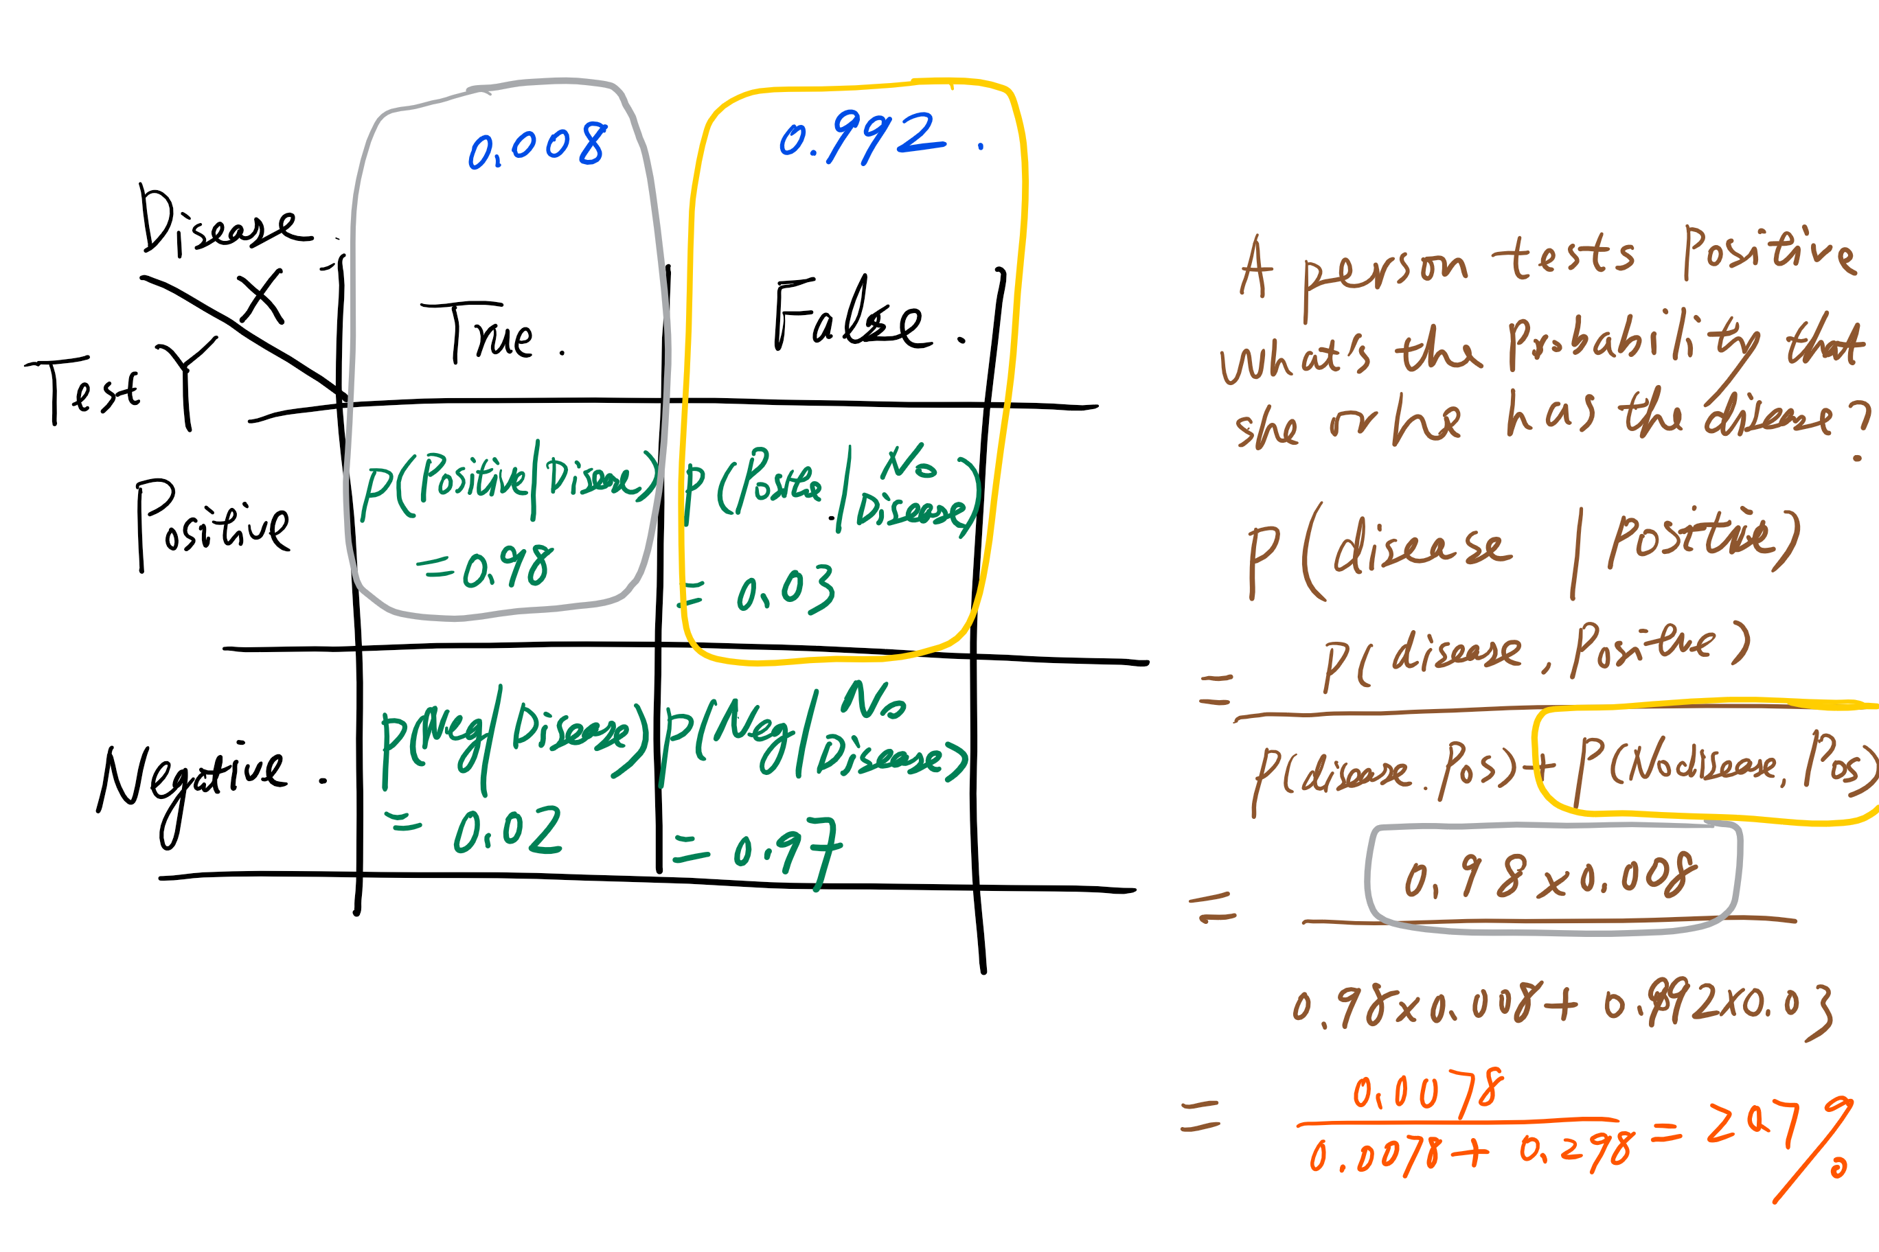

Slide 26
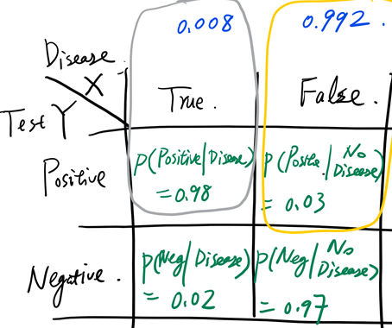
Example (cont’d)
Let’s say test returns positive result…
What is MAP hypothesis?
P(X | Pos) = P(Pos | X) P(X) = .98 * .008 = .0078
P(~X | Pos) = P(Pos |~X) P(~X) = .03 * .992 = .0298
P(~X | Pos) > P(X | Pos) , so h_{MAP} = ~X
What is ML hypothesis? (Drop priors)
P(Pos | X) > P(Pos | ~X), so, h_{ML} = X
Bayesian methods depend heavily on priors
“correct” answer depends on priors
20.7%
79.3%
Different!

Slide 27
Intuition
Why does h_{MAP} say it is more likely patient doesn’t have disease X, when test is positive?
Compare:
Rarity of disease
FP rate of test
Disease is rarer than a positive result
P(X) = 0.008
prob. of having X
P(Pos | ~X) = .03
prob. of false positive
Consider population of n = 500
500*.008 = 4 people have disease X
500*.03 = 15 people get false positive diagnosis

Slide 28
Bayes Optimal Classifier
Bayesian Decision Theory gives us a lower bound on the classification error that can be obtained for a given problem
Class A
Posterior
probability
Class B
Feature x
Optimal decision threshold
What is the minimum error rate that is ever possible?

Slide 29
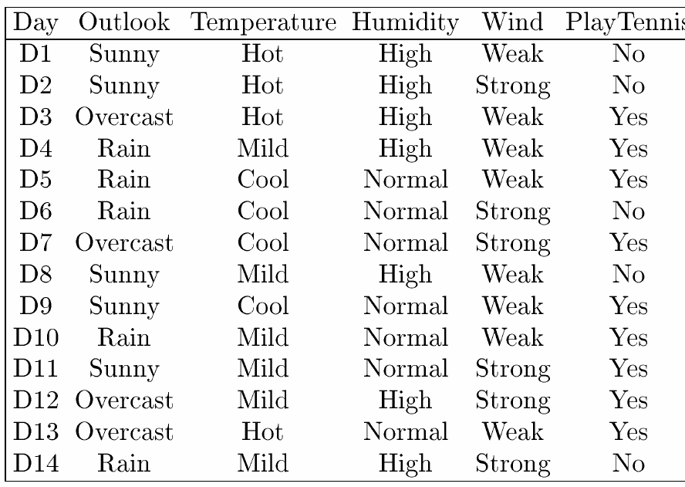
Naïve Bayes Classifier
Consider discrete attributes…
Bayesian Approach:
v_{MAP} = argmax_{vj∈ V} P(v_{j}|a₁,a₂,..,a_{n})
= argmax_{vj∈ V} [P(a₁,a₂,..,a_{n}|v_{j}) P(v_{j})/P(a₁,a₂,..,a_{n})]
= argmax_{vj∈ V} P(a₁,a₂,..,a_{n}|v_{j}) P(v_{j})
Label
Attributes
Training Data
Hard to estimate unless we have a LOT of data
Easy to estimate (by counting)

Slide 30
Naïve Bayes Classifier (cont’d)
We need to see every instance many times to estimate P(a₁,a₂,..,a_{n}|v_{j})
Let’s be naïve…
Assume that the attribute values are conditionally independent
P(a₁,a₂,..,a_{n}|v) =∏_{i} P(a_{i}|v) Naïve Bayes Classifier:
v_{NB} = argmax_{vj∈ V} P(v_{j}) ∏_{i} P(a_{i}|v_{j})
Works very well on real data
Can get this by counting

Slide 31
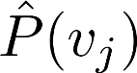
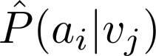
Naïve Bayes Classifier Algorithm
Naïve_Bayes_Learn(examples)
For each target value v_{j}
← estimate P(v_{j})
For each value a_{i} of each attribute a
← estimate P(a_{i} | v_{j})
Classify_New_Instance(x)
v_{NB} = argmax_{vj∈ V} P(v_{j}) ∏_{i} P(a_{i}|v_{j})

Slide 32
Naïve Bayes Example
Classify: <S, C, H, S>
Compute: v_{NB} = argmax_{vj∈ V} P(v_{j}) ∏_{i} P(a_{i}|v_{j})
P(y)P(S|y)P(C|y)P(H|y)P(S|y) = .005
P(n)P(S|n)P(C|n)P(H|n)P(S|n) = .021
Classification (v_{NB}) = n
See any problems?
9/14
2/9

Slide 33
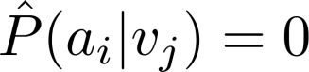
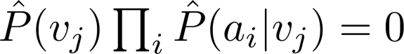
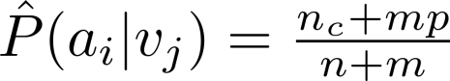
Subtleties with NBC
What if none of the training instances with target value v_{j} have attribute value a_{i}?
, so…
Typical solution is Bayesian estimate for
where n is the number of training examples for which v = v_{j}
n_{c} is the # example where v = v_{j} and a = a_{i}
p is the prior estimate for
m is the weight given to prior (# of virtual examples)

Slide 34
Subtleties with NBC
Conditional independence assumption is often violated
NBC still works well, though,
Don’t need actual value of posterior to be correct
Only that argmax_{vj∈ V} P(v_{j}) ∏_{i} P(a₁,a₂,..,a_{n}|v,) = argmax_{vj∈ V} P(v_{j}) ∏_{i} P(a_{i}|v_{j})
NBC posteriors often (unrealistically) close to 0 or 1

Slide 35
Recap
Bayesian Learning
Strong statistical bias
Uses probabilities to rank hypotheses
Common framework to compare algorithms
Algorithms
Bayes Optimal Classifier
Gibbs Algorithm
Naïve Bayes Classifier

